Slide 1
In the meantime…
Chill music

Slide 2
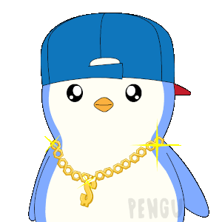

Introduction to LangChain
Beginner Workshop

Slide 3
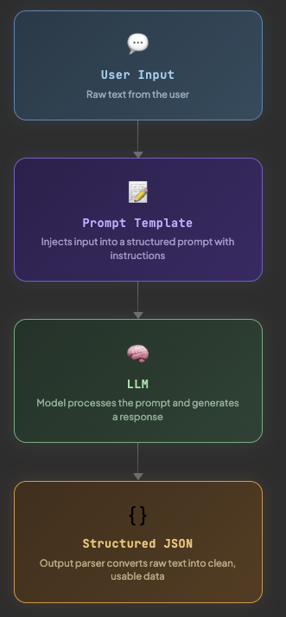
What is LangChain?
🔌 Connect Plug into any LLM – OpenAI, Groq, Hugging Face, Anthropic – swap any model
🔗 Chain Link steps together into a pipeline: prompt → model → parse → structured output
🧩 Extend Add documents, memory, APIs, and tools

Slide 4
What is LangChain?
Open-source development framework for LLM applications
Python and JavaScript (or TypeScript) packages are available
Focused on Composition and modularity
Key value adds:
Modular Components
Use cases: Common ways to combine components
Chase, H., & Ng, A. (n.d.). LangChain for LLM application development [Online short course]. DeepLearning.AI. Retrieved September 24, 2025, from https://www.deeplearning.ai/short-courses/langchain-for-llm-application-development/

Slide 5
What exactly is it?
Lang stands for language, which is the primary focus, and chain - the connotation of connecting things - refers to the chain component.
Chains are a sequences of instructions that the framework executes to perform a task.
It's about orchestration:
Chain multiple LLM calls together
Access external data (APIs, databases, documents, search, etc)
Remember context (short-term and long-term memory)
Control flow with tools, agents and structured reasoning

Slide 6
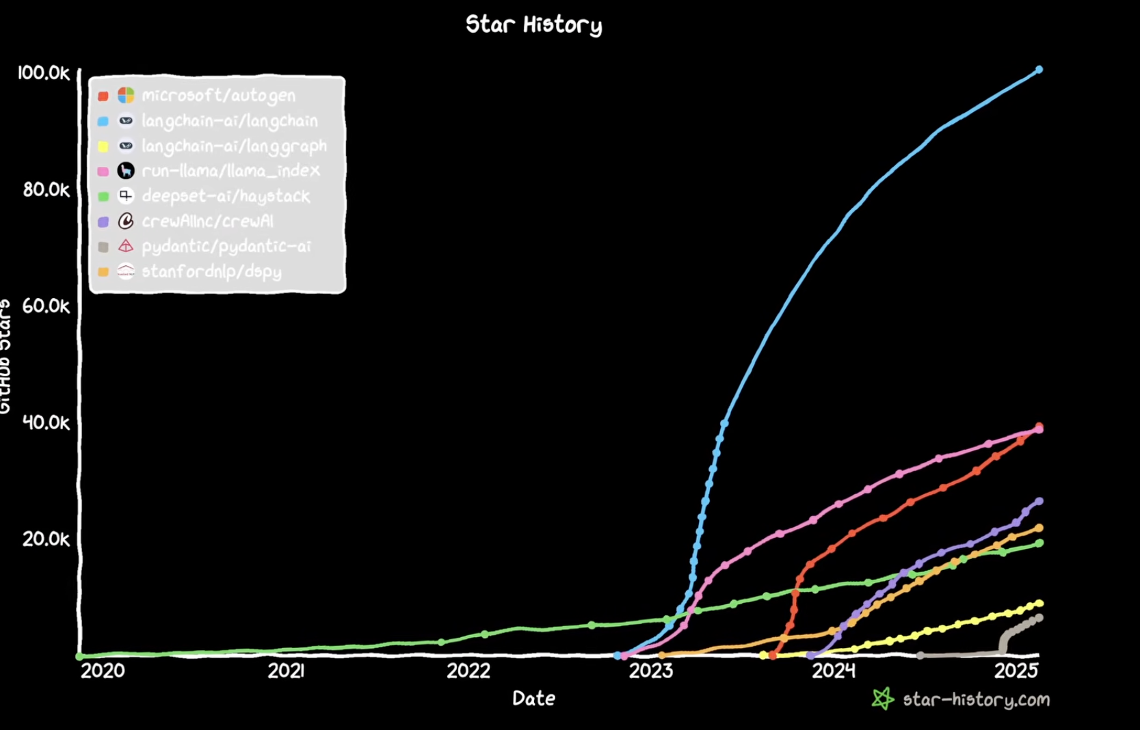
Why LangChain?
🚀 Adoption Linkedin, Uber, Replit, BCG, Klarna – all running LangChain in production
⚡️Speed to build Eliminates boilerplate code – Replaced with ~5 lines of LCEL
🔀 Model Agnostic: Switch from OpenAI to Groq to Hugging Face
Notes:
LangChain has more GitHub stars than every other LLM framework combined. Companies are using it in production, job postings list it as a skill, and it supports every major model provider. The biggest reason for us today: it turns what would be 50 lines of messy API code into a clean 5-line pipeline. That's what we're going to build

Slide 7
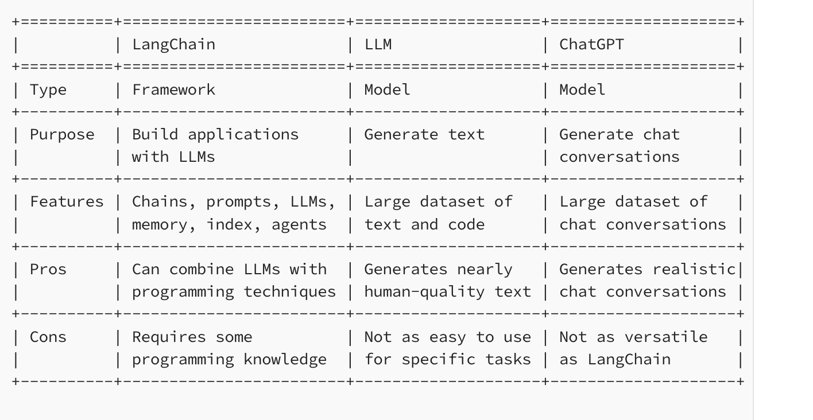
LangChain vs Raw API Calls
Reference from https://medium.com/@ivanreznikov/langchain-101-course-updated-668f7b41d6cb#678f

Slide 8
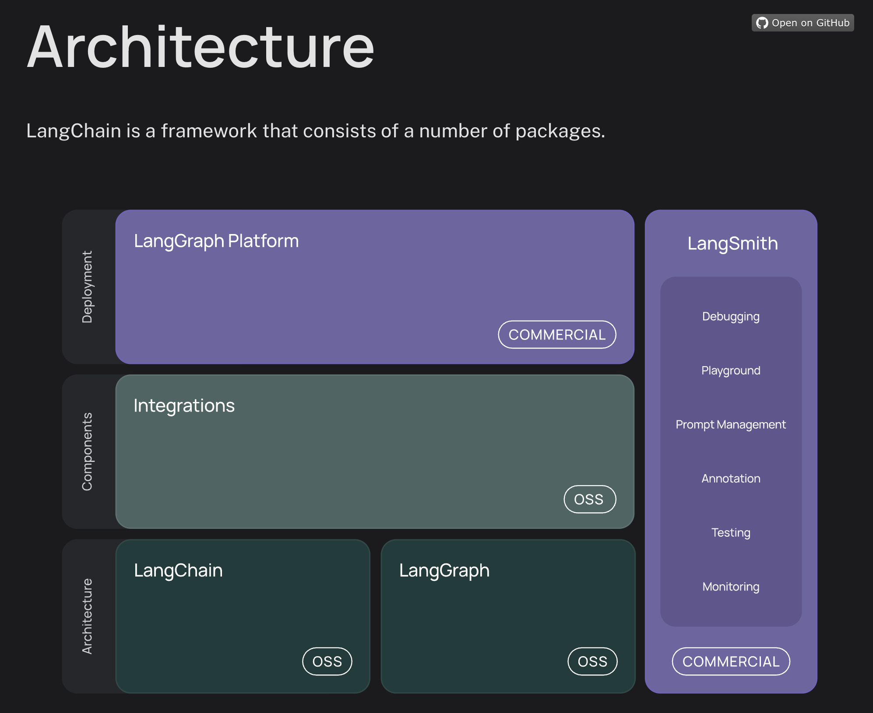
Notes:
LangChain is actually an ecosystem of tools, not just one library.
At the bottom you have the core — LangChain and LangGraph. These are open source and free. LangChain is the foundation: it gives you building blocks like prompt templates, model wrappers, output parsers, and the pipe syntax to chain them together. That's 90% of what we'll use today.
LangGraph sits next to it — it's for when you need more complex flows, like agents that can decide which tools to call, or workflows with branching and loops. We won't touch it today, but if you continue to Part 2, you'll see where it fits.
The middle layer is integrations — this is where LangChain connects to the outside world. OpenAI, Groq, Hugging Face, vector databases like FAISS or Pinecone. The beauty is you plug them in with one line. Switch from OpenAI to Groq? Change one import. Your chain stays the same.
On the right side is LangSmith. Think of it as Chrome DevTools but for LLM applications. When your chain gives a weird answer, LangSmith lets you trace every step — what prompt was sent, what the model returned, where it went wrong. Companies like Klarna use this to monitor millions of conversations.
The top layer is LangGraph Platform — that's the deployment and hosting layer. Commercial product, not something we'll deal with today.
Here's the key takeaway: today we're focused entirely on the bottom-left box — LangChain core. Prompts, models, parsers, chains. Once you master these building blocks, everything else in this diagram is just an extension of what you already know.

Slide 9
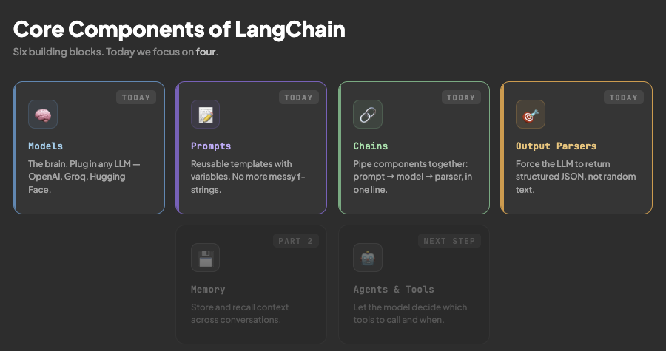

Slide 10
Deep Dive into Workshop Focus
Today, we’ll go deeper into these areas:
Models: LangChain lets you plug in different LLMs. We are going to plug in an open source LLM from Hugging Face
Prompts: Instead of raw strings, LangChain gives you structured prompt templates. Allowing you to inject variables, manage context, and avoid mistakes in prompt engineering.
Chains: Sequences that tie components together
Output Parsers: Allows you to parse the model’s raw text into structured output

Slide 11
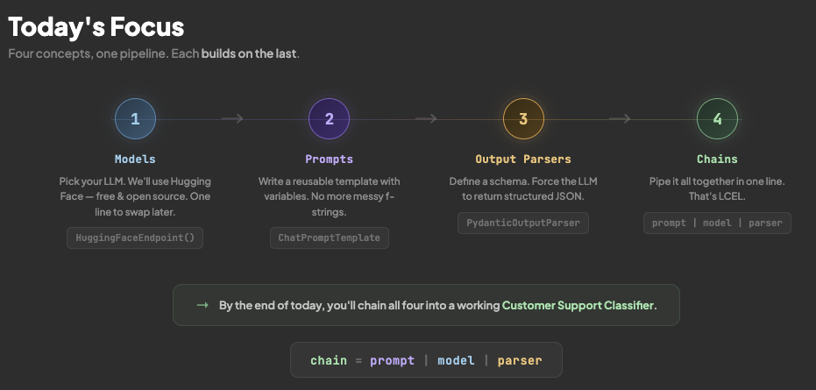

Slide 12
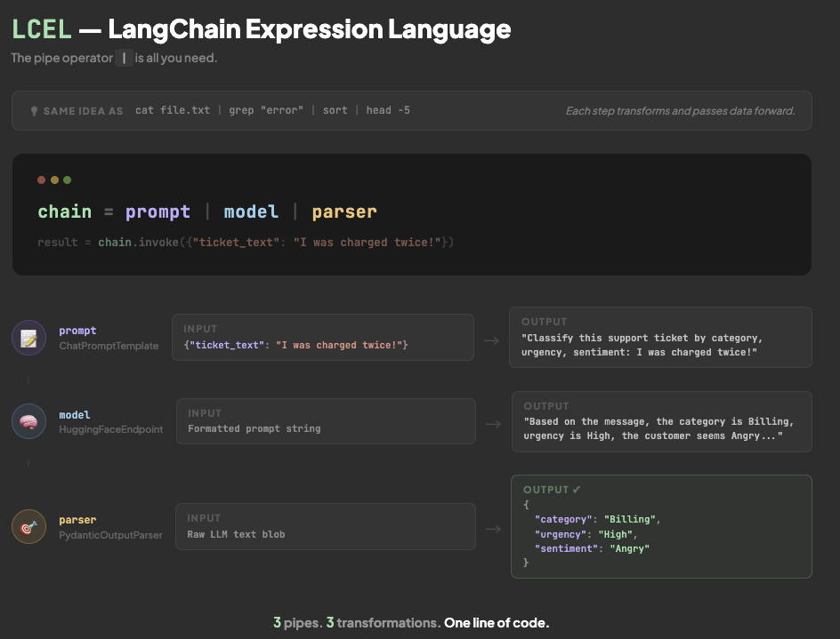

Slide 13
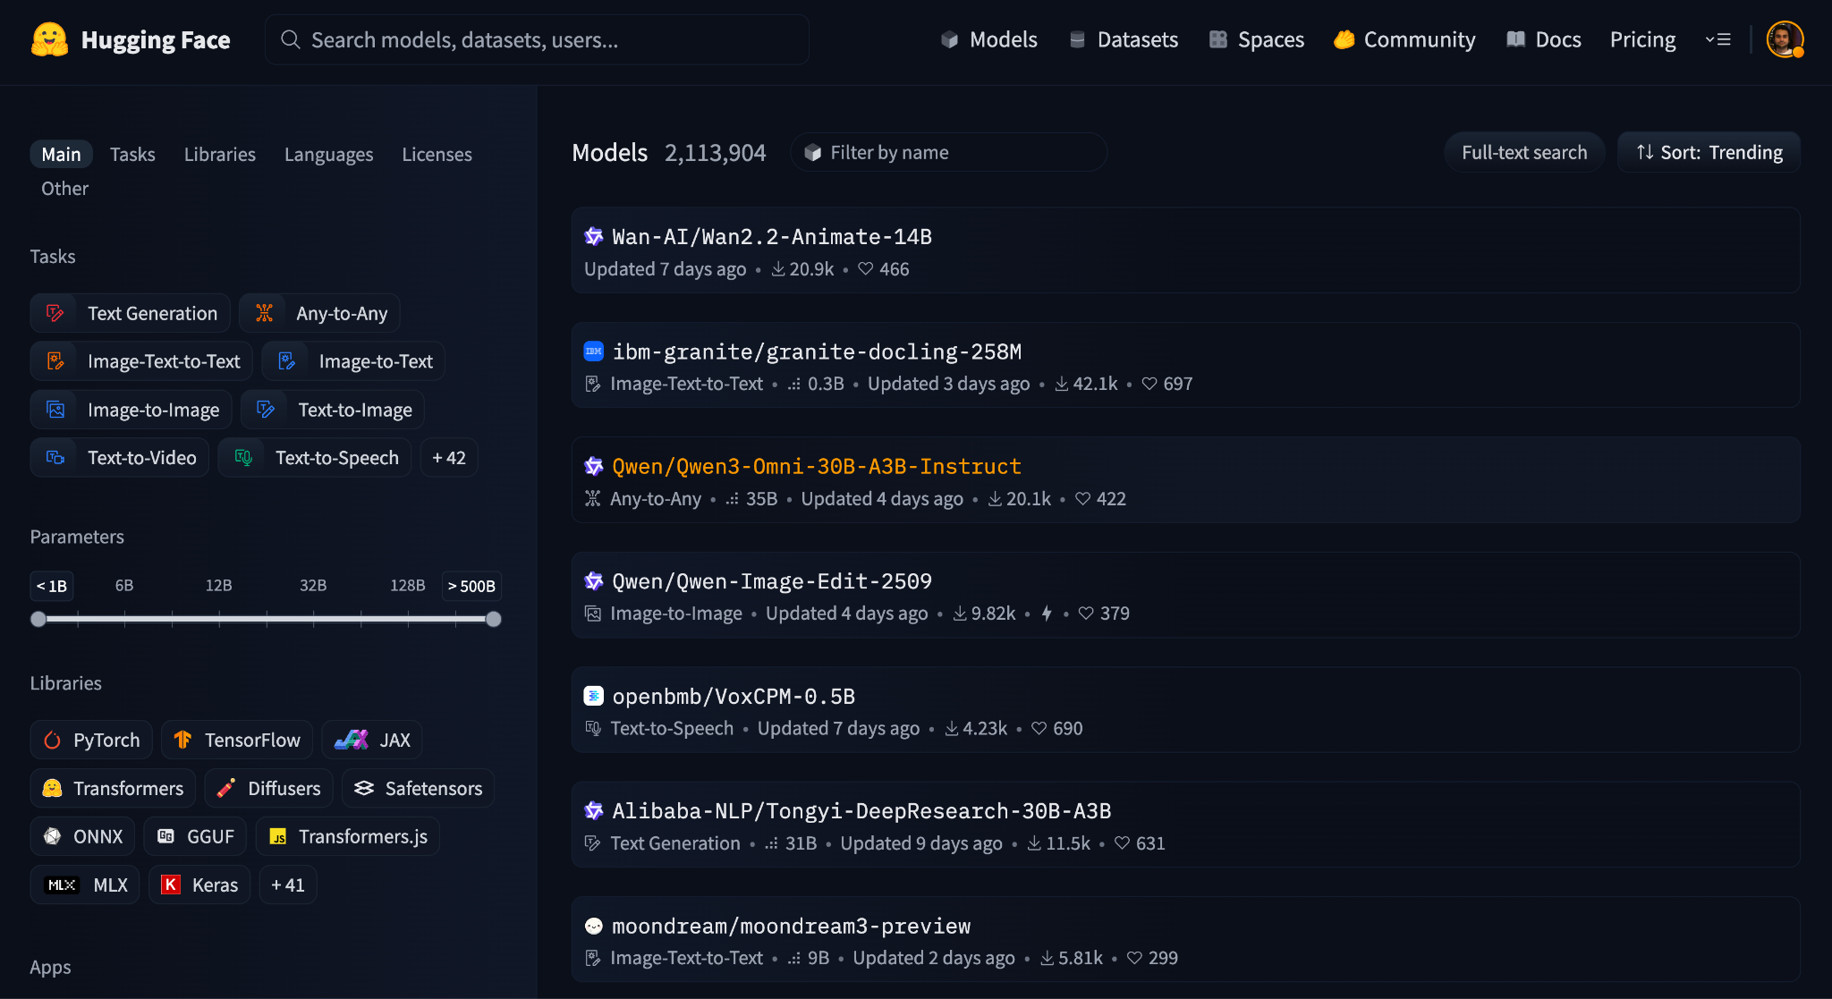

Slide 14
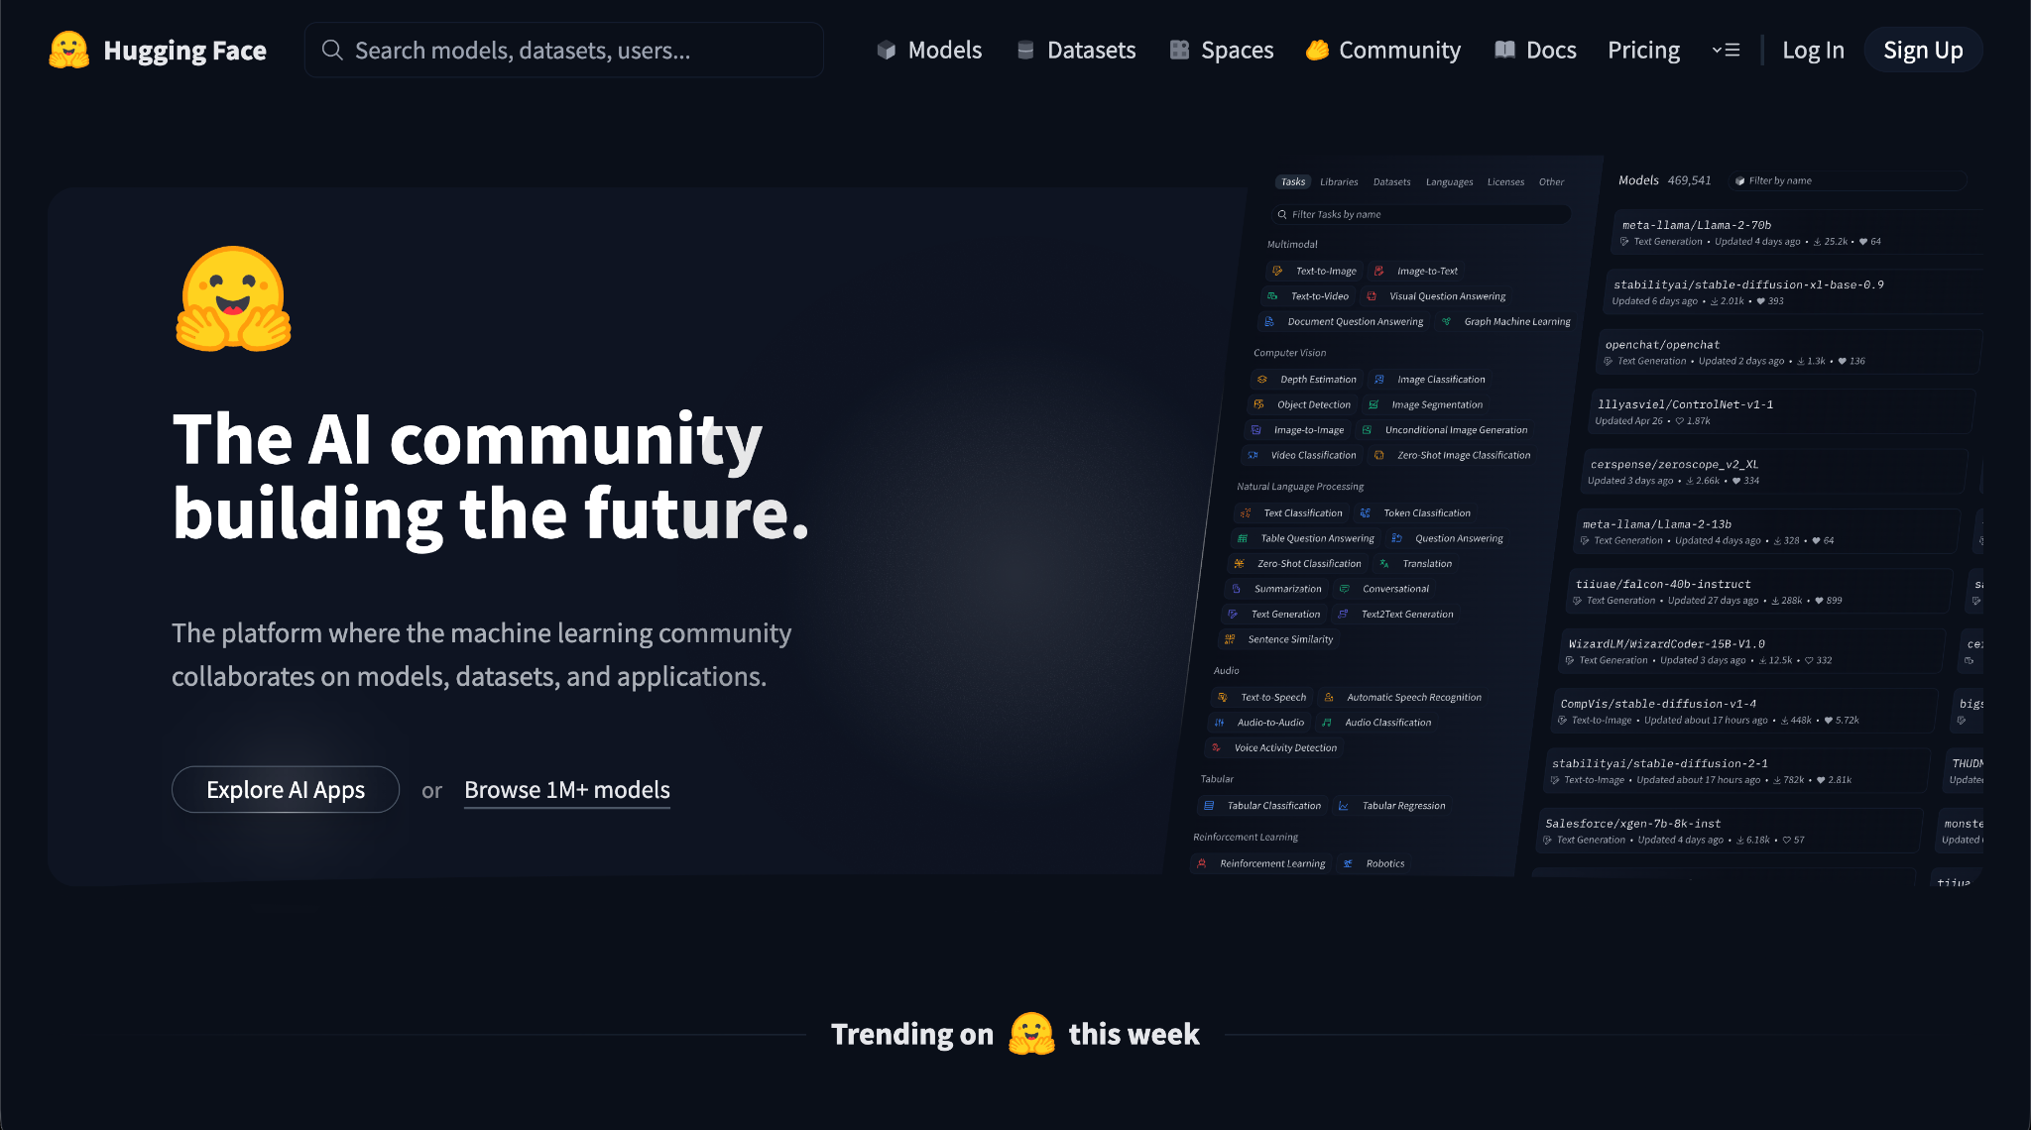
Notes:
Models are the foundation. LangChain lets you plug in different LLMs—from OpenAI, Anthropic, Cohere, or Hugging Face.
For example, Hugging Face hosts thousands of open-source models—from small distilled models to large instruct-tuned LLMs.

Slide 15
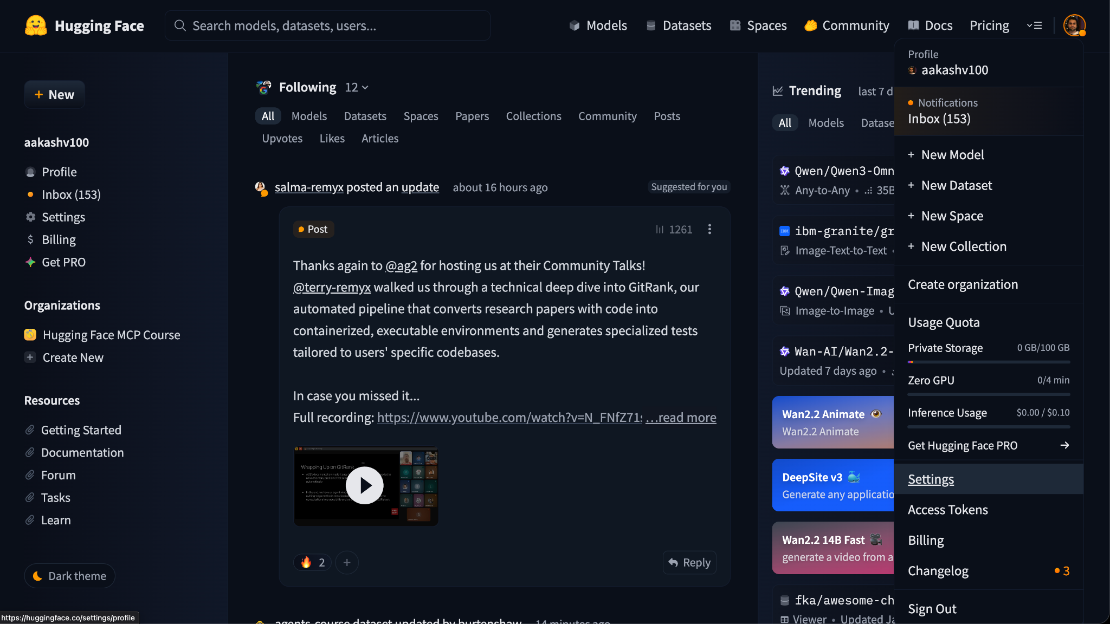

Slide 16
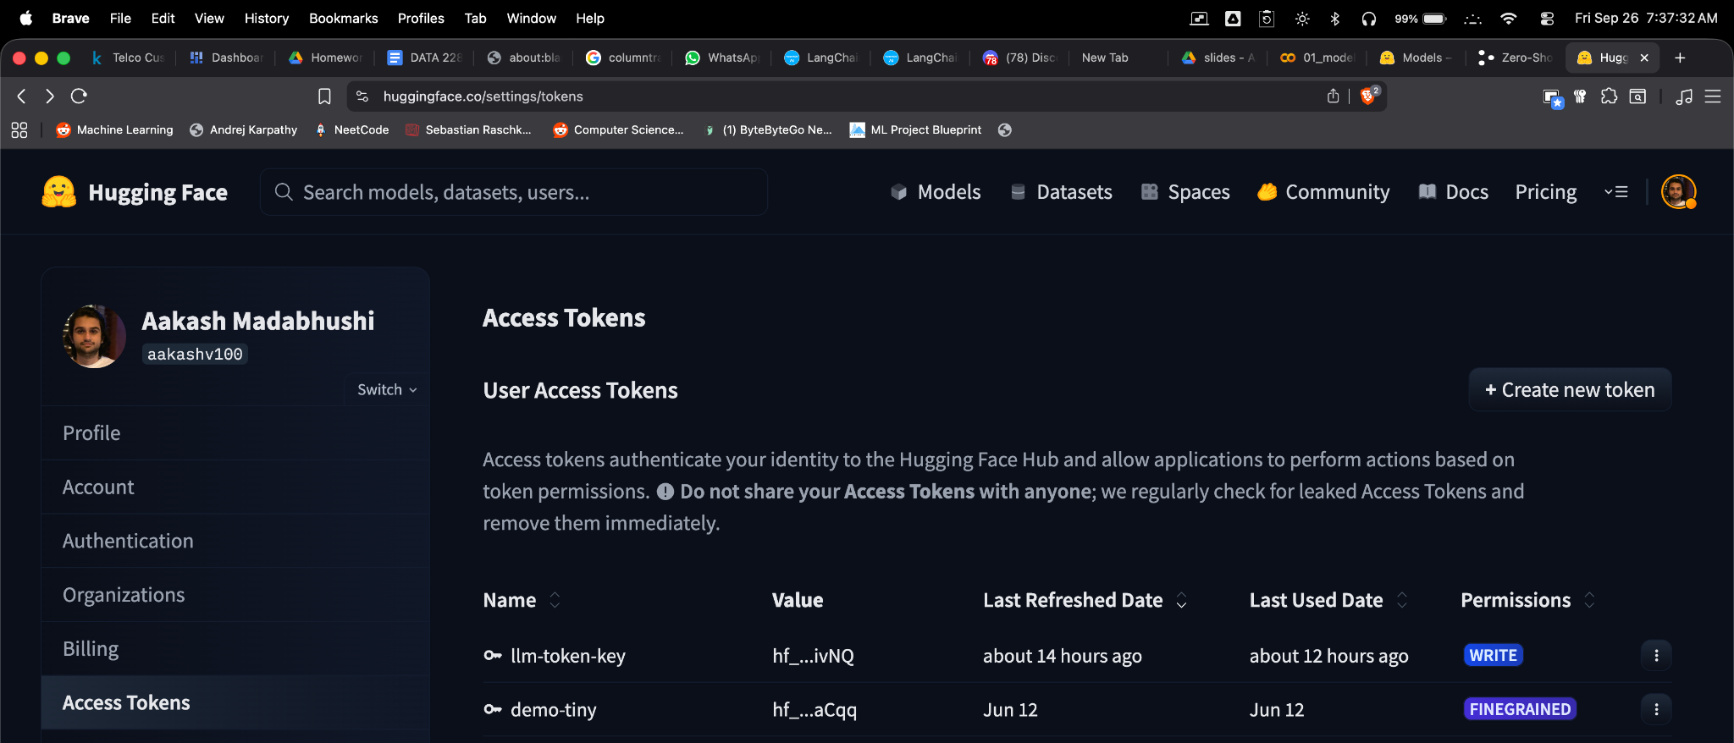

Slide 17
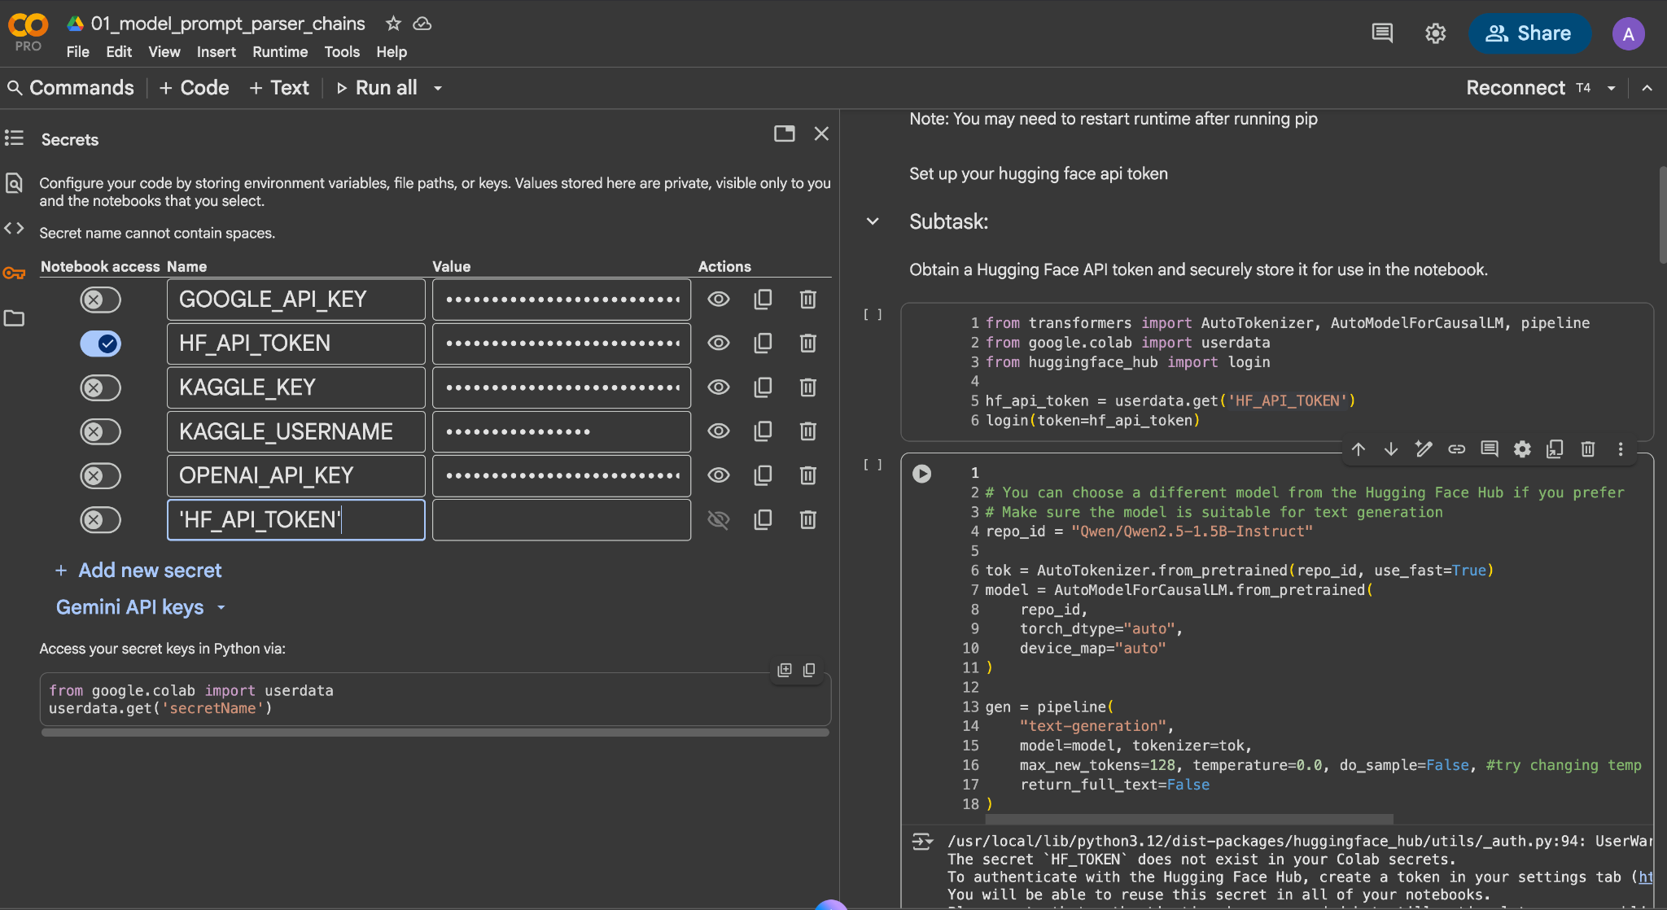
Copy & Paste Token Key here

Slide 18
Click the Colab Link: here

